Slide 1
Mini Project 1
Project Title:
Multi-Category Shop

Slide 2
PROBLEM:
Where can I post my Affiliate products?
How they can directly buy on this shop?
How to Promote products?
How to be a Seller or Affiliate Marketer?
How to have an extra income in this time of hard days?

Slide 3
Solution:
This will be a showcase of my products online
- where they can get to see and explore my products
Directly add to cart and checkout on the site
Help those who need extra income, become a seller or Affiliate Marketer

Slide 4
Target Users/Audience:
Online Entrepreneurs
Clients
Shoppers

Slide 5
Introduction:
This will be our products showcase website, where the clients could explore and freely choose what they want to buy. And also, can bridge Sellers/Affiliate Marketers to earn an extra income.

Slide 6
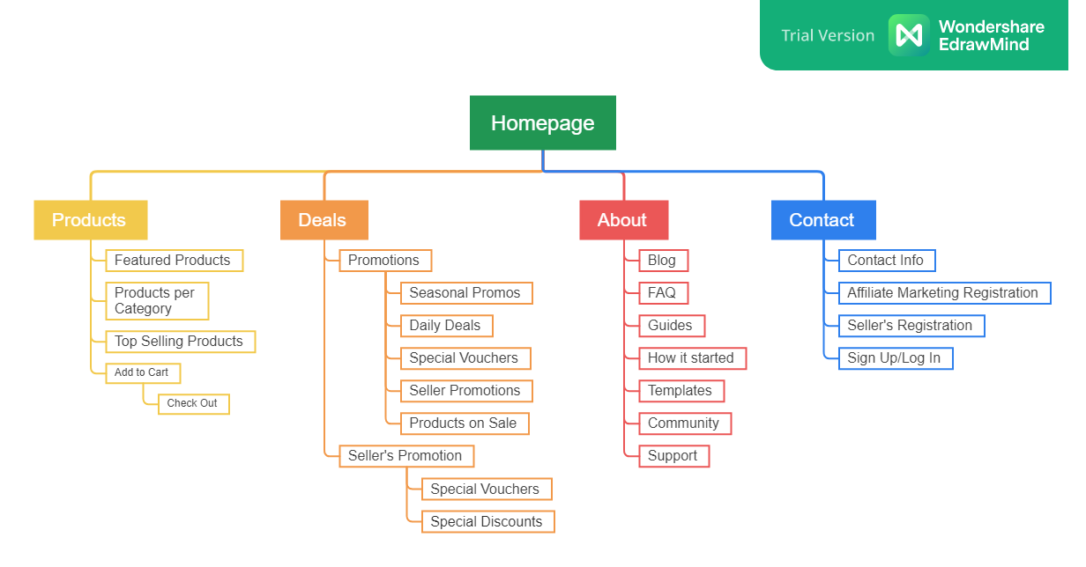
SITEMAP

Slide 7
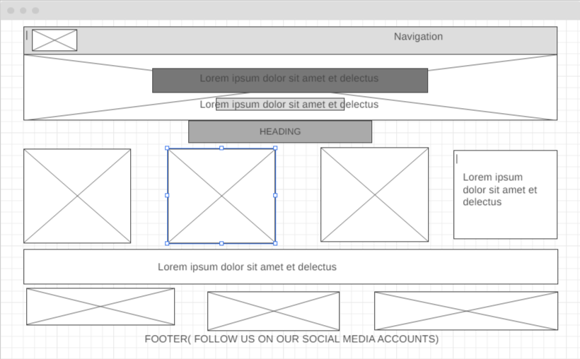
WIREFRAME (HOME)

Slide 8
ArjhenTV Shop is a Multi-Category Shop that serves people with a lot of choices on the world wide web. It offers more promotions, deals, and special vouchers to customers, Sellers, and Affiliate Marketers.
Features:
HomePage
About Page
Product Page
Deals Page
Contact Page
Blog Page
Details Page

Slide 9
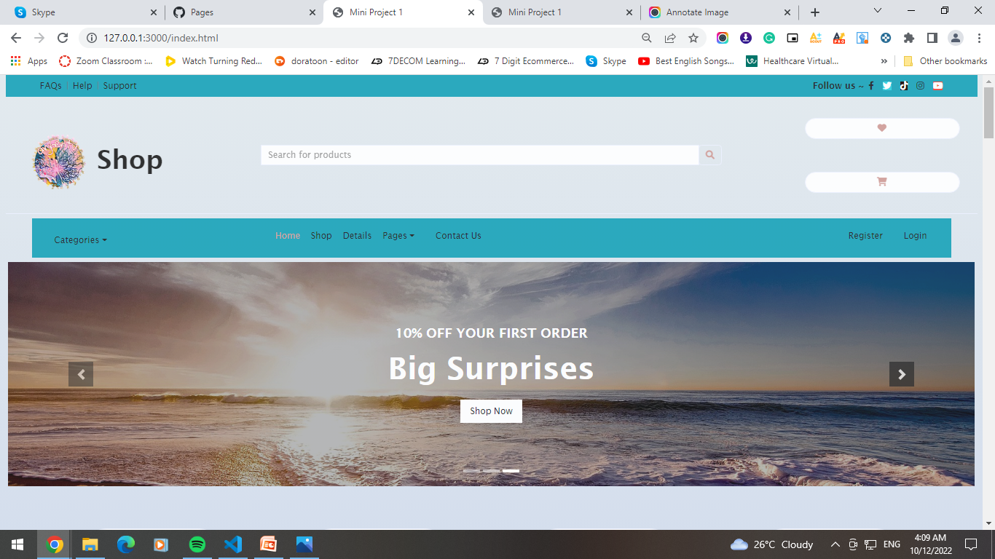
HOME PAGE

Slide 10
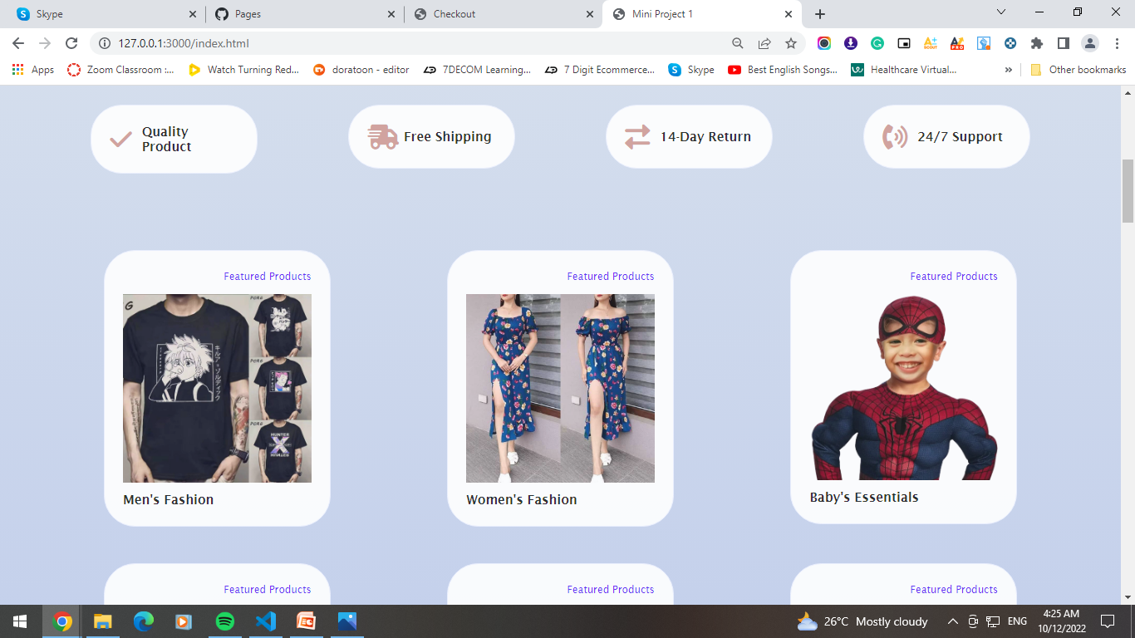

Slide 11
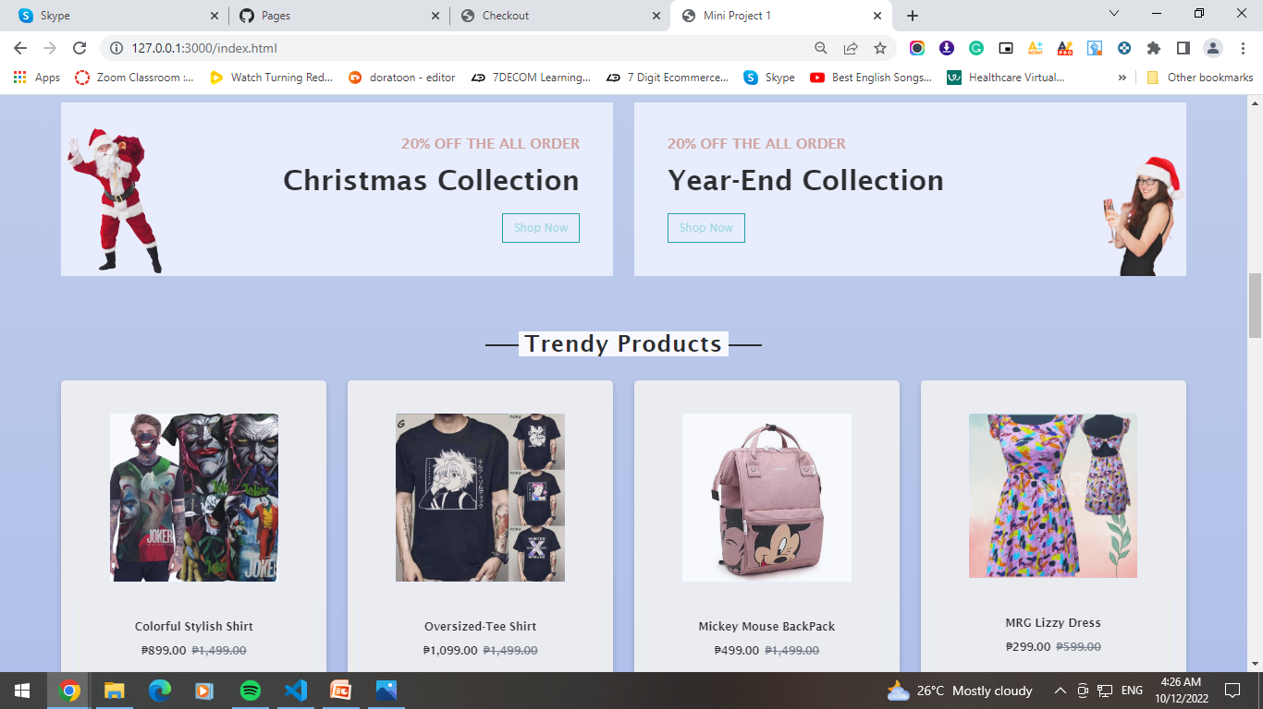

Slide 12
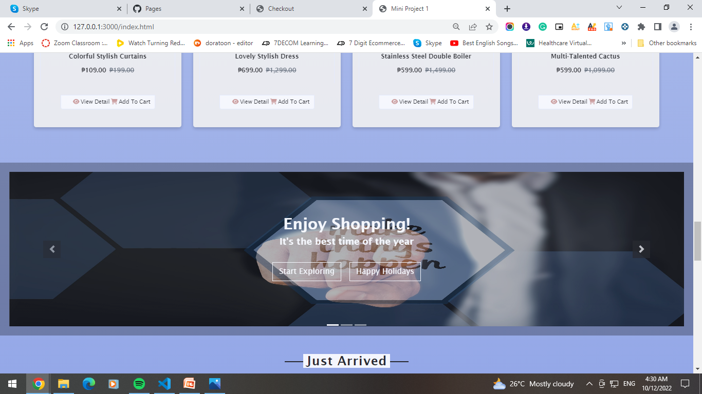

Slide 13
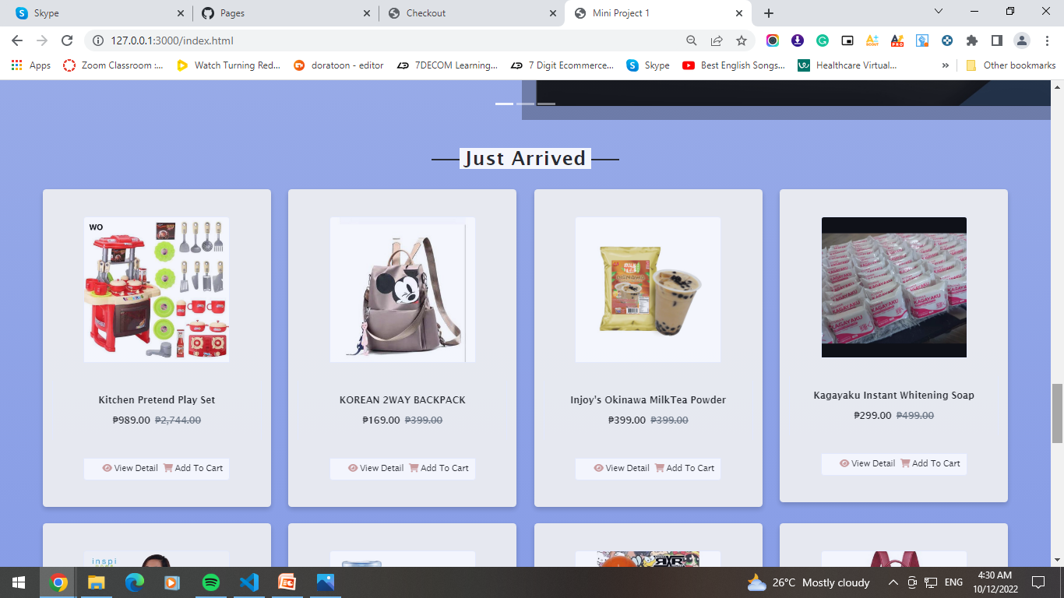

Slide 14
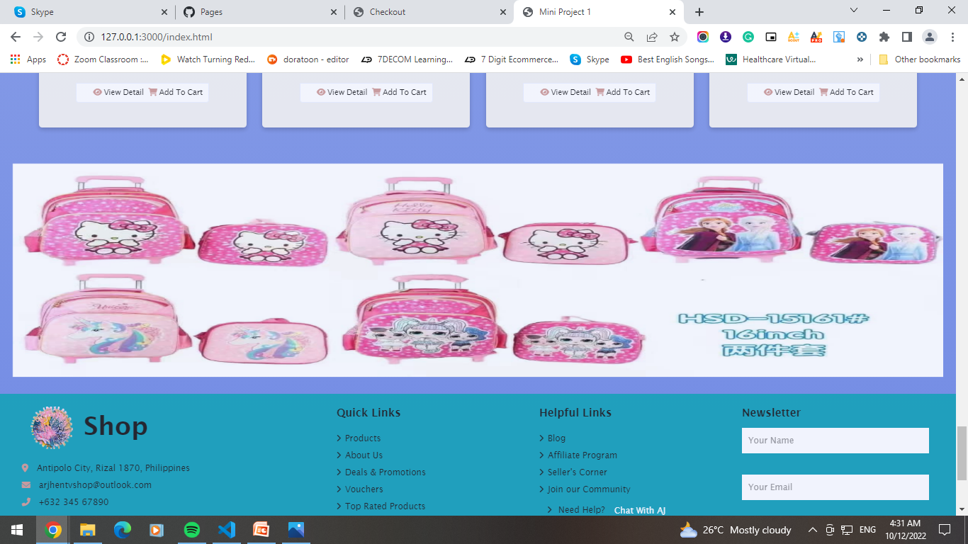

Slide 15
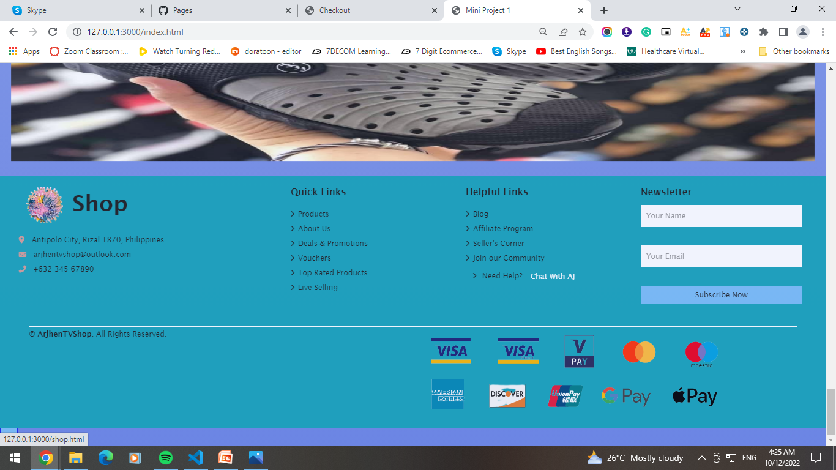

Slide 16
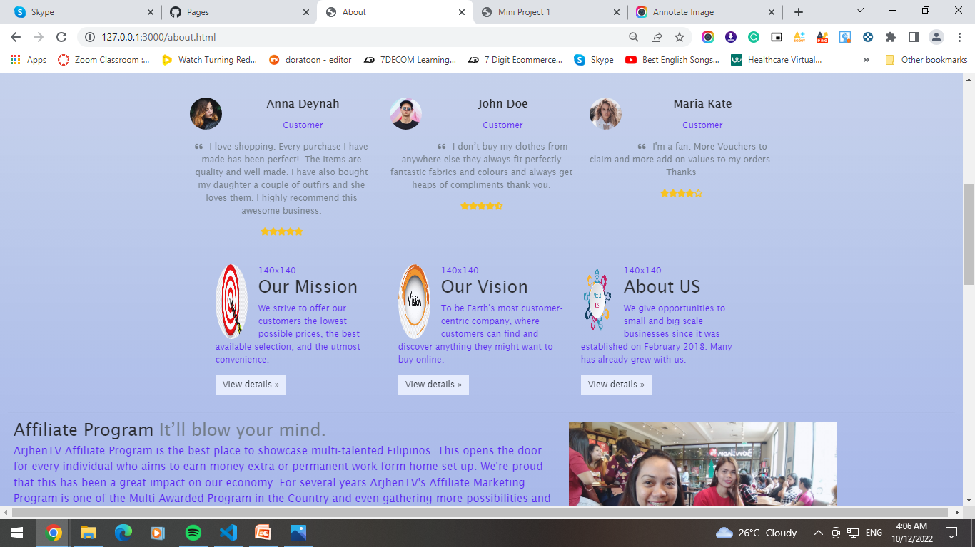
ABOUT PAGE

Slide 17
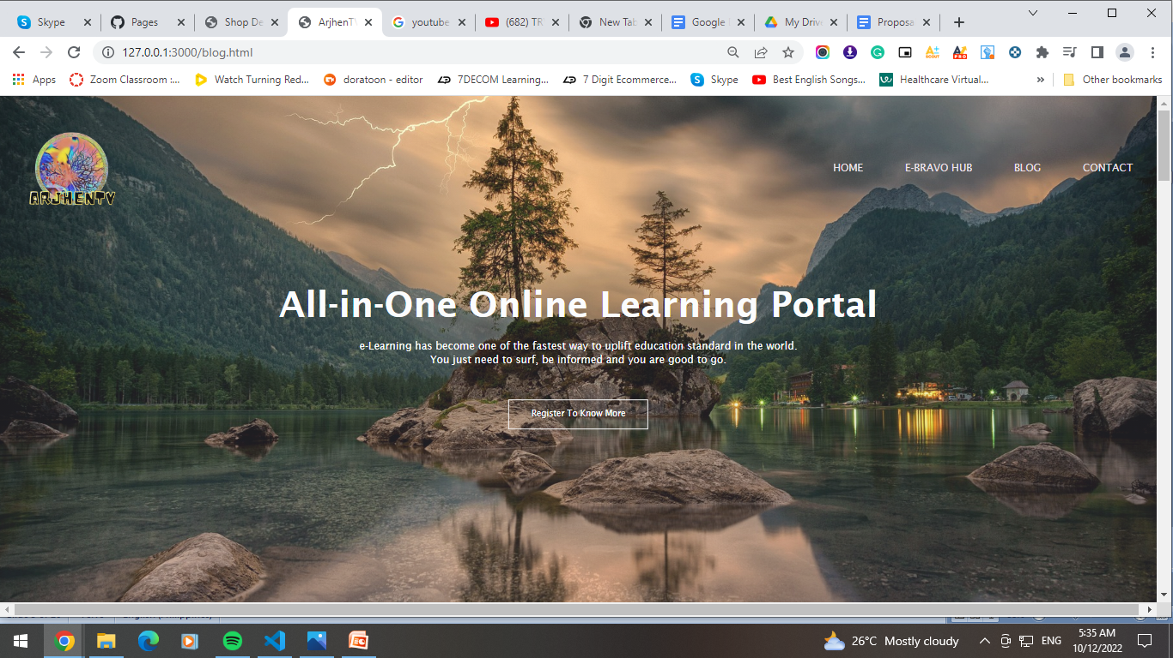
BLOG PAGE

Slide 18
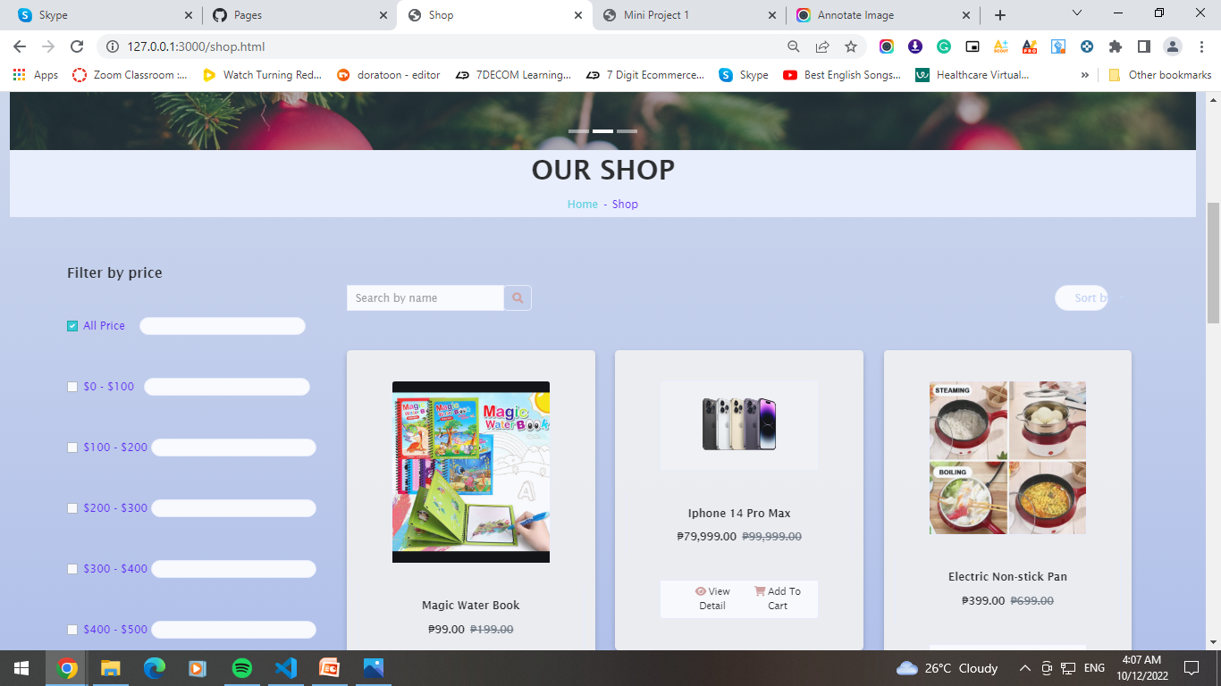
SHOP PAGE

Slide 19
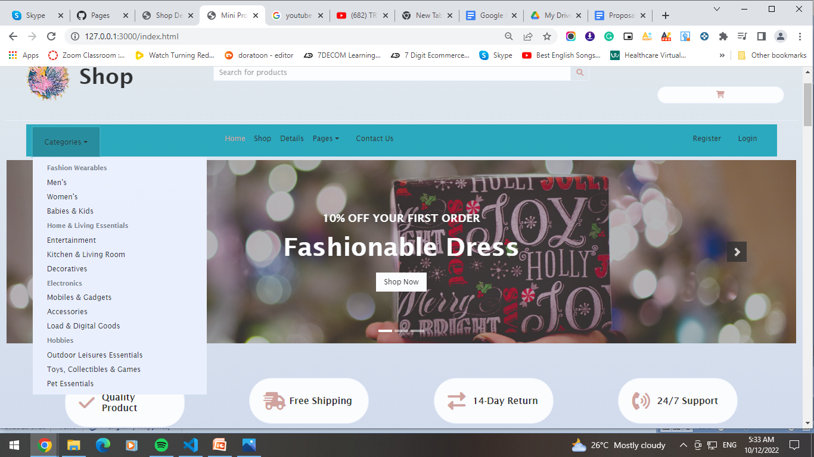
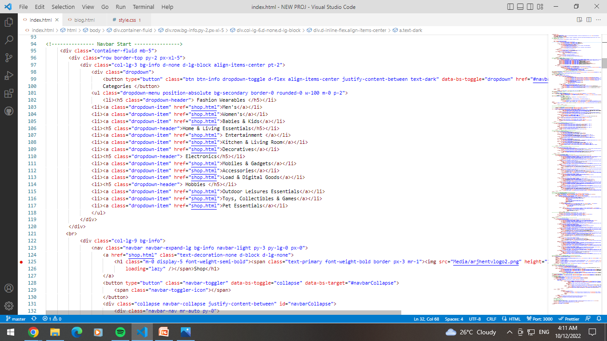
DROPDOWN

Slide 20
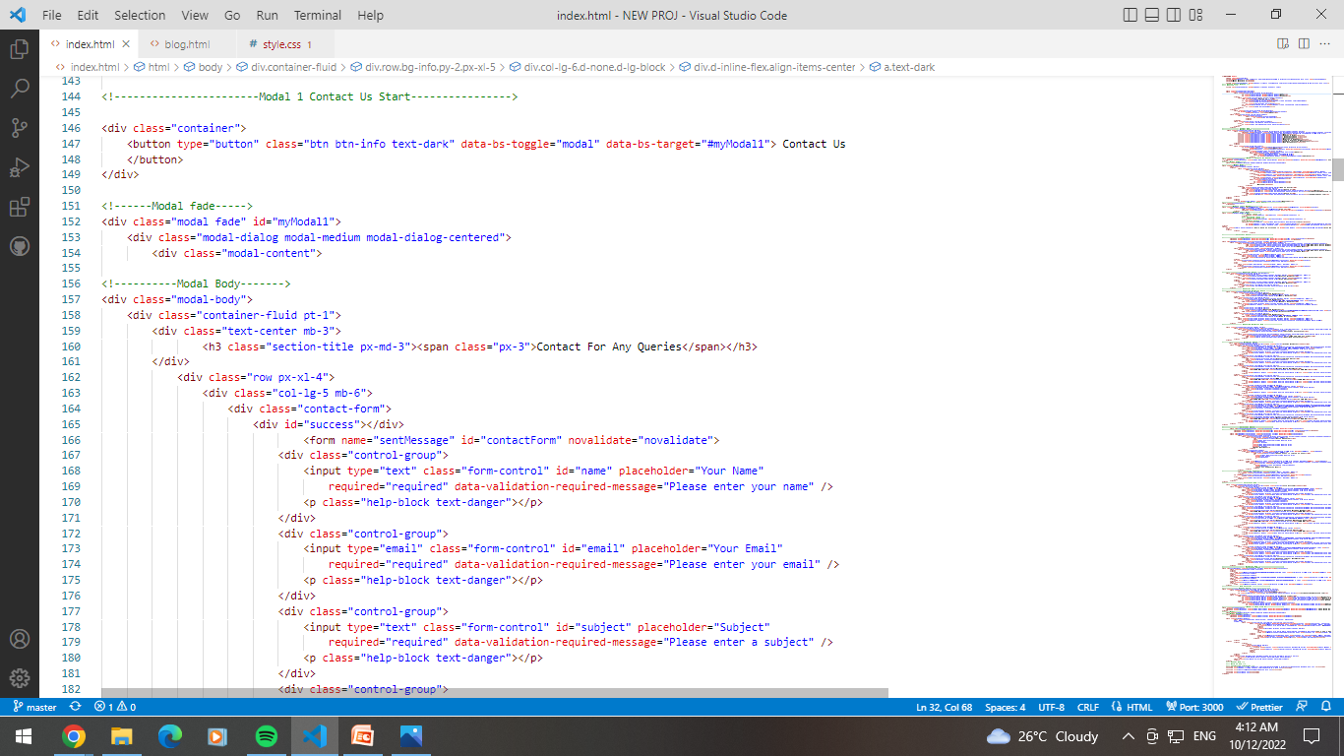
MODAL (CONTACT US)

Slide 21
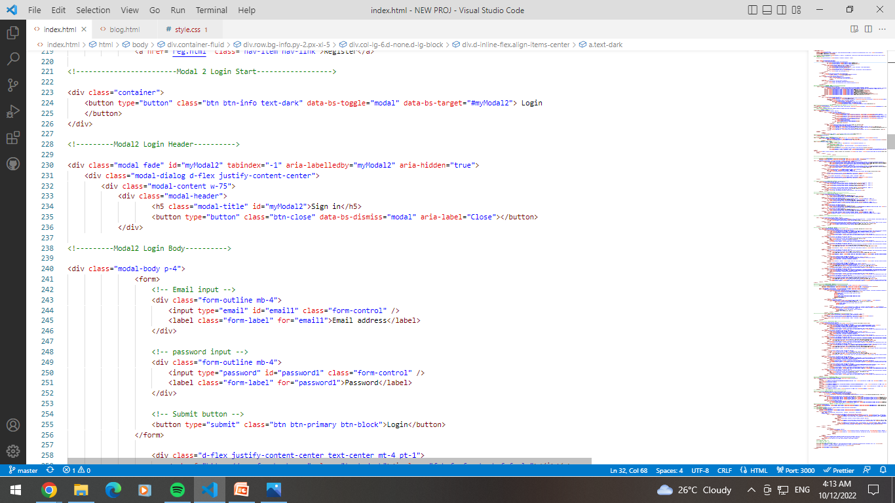
MODAL (LOGIN)

Slide 22
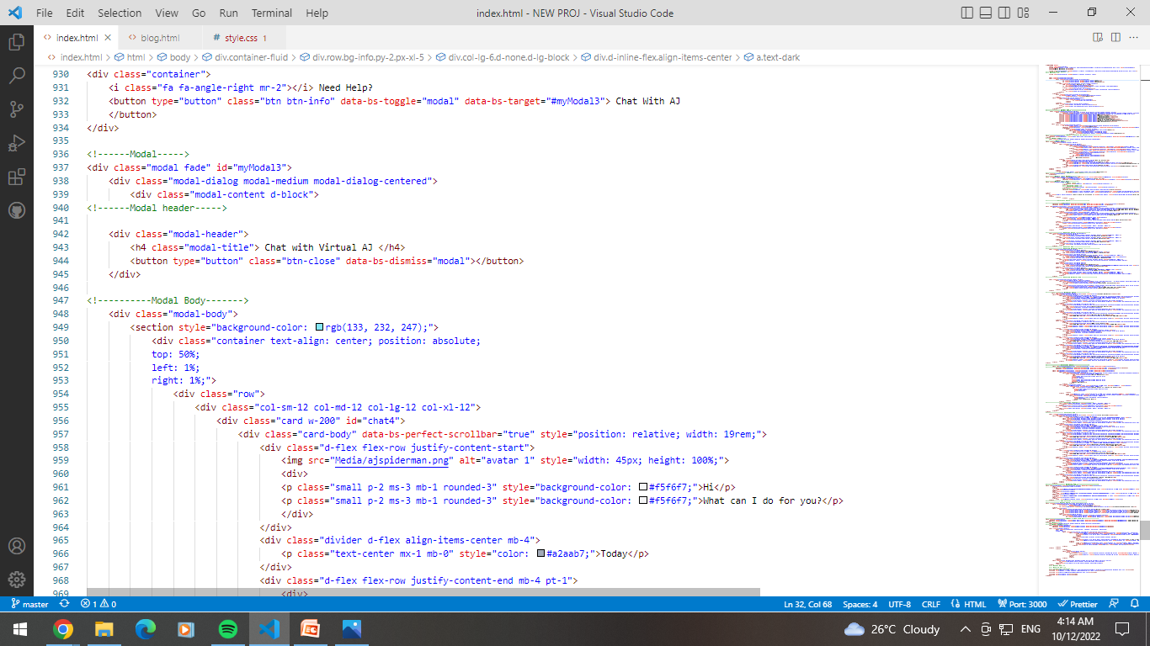
MODAL (CHATBOX)

Slide 23
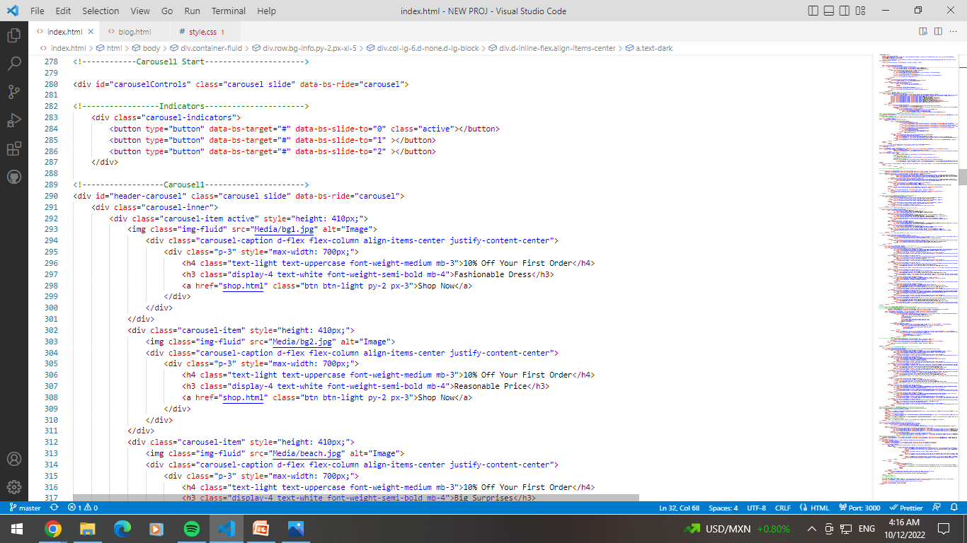
CAROUSEL

Slide 24
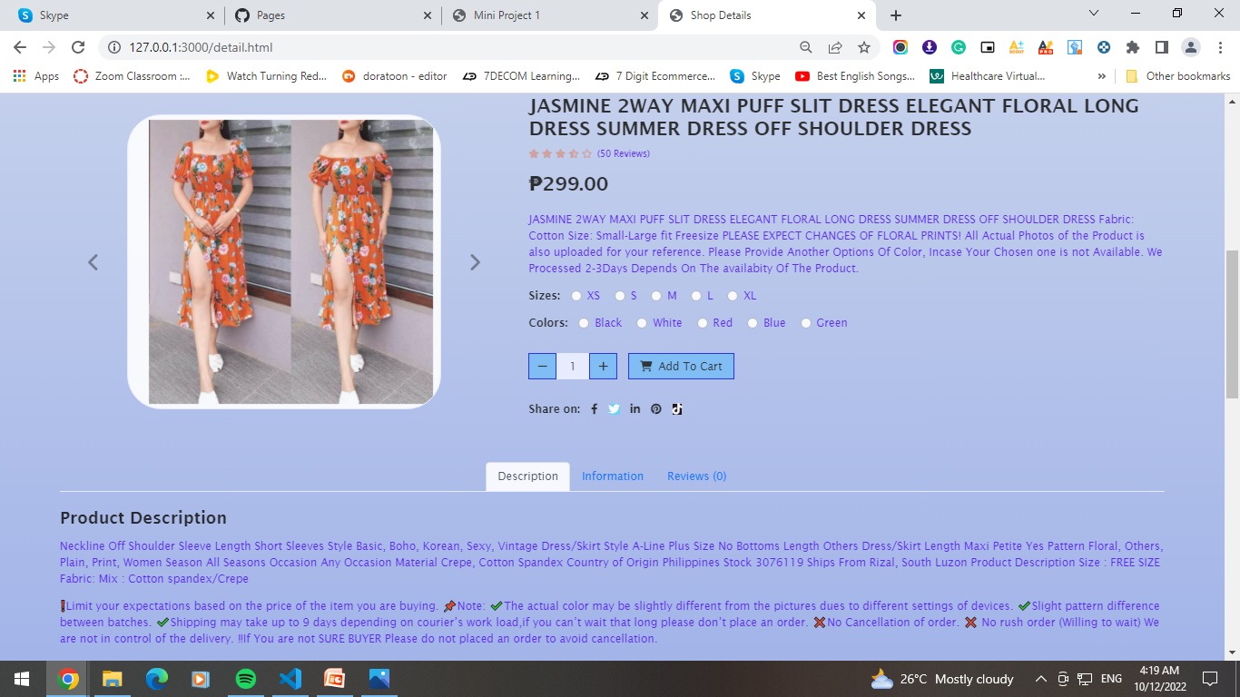
SHOP DETAILS PAGE

Slide 25
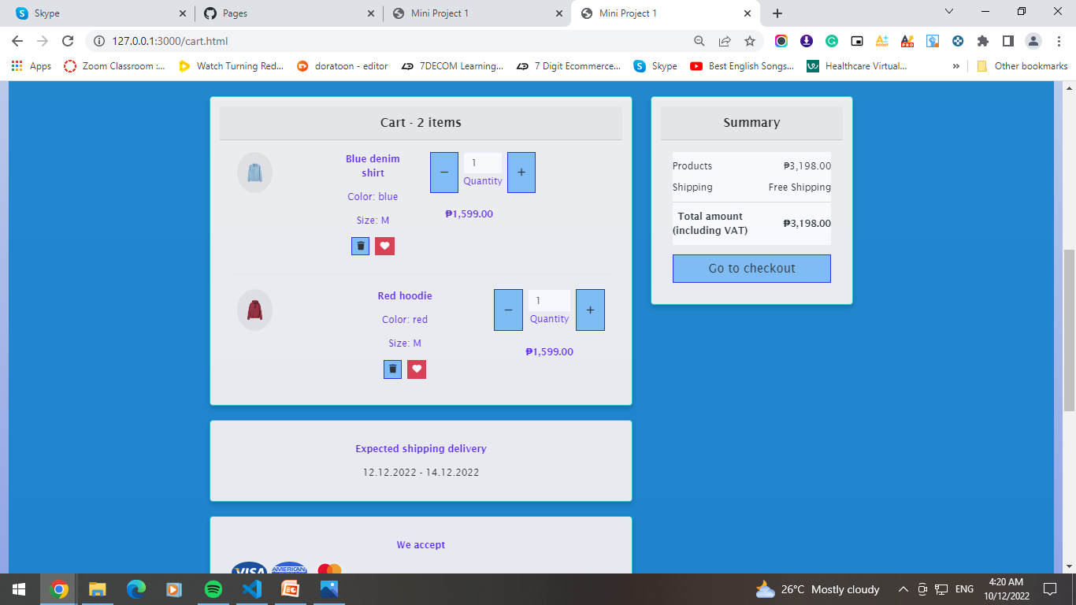
CART

Slide 26
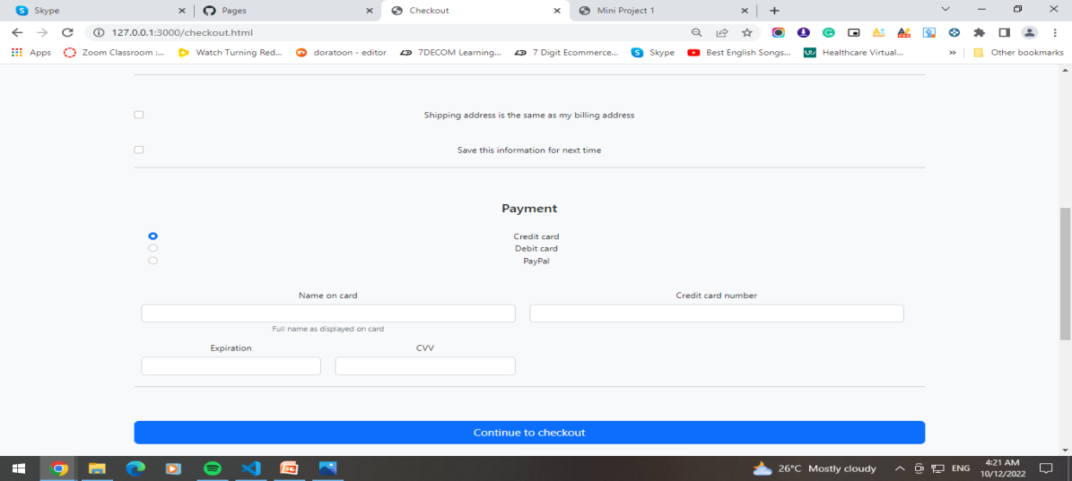
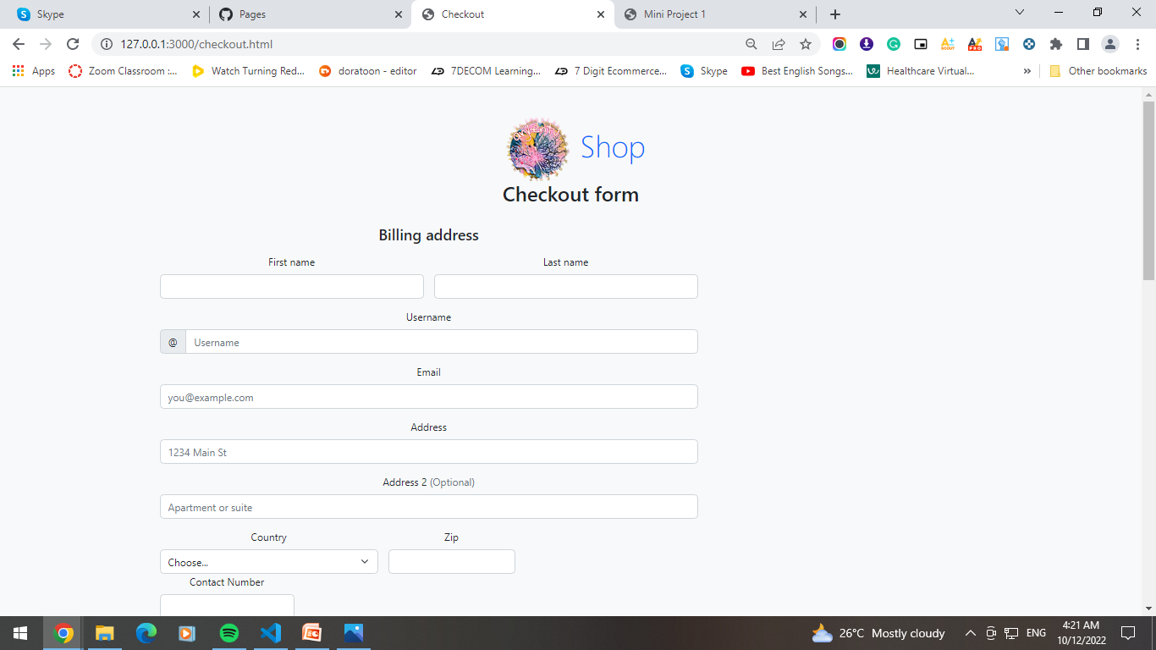
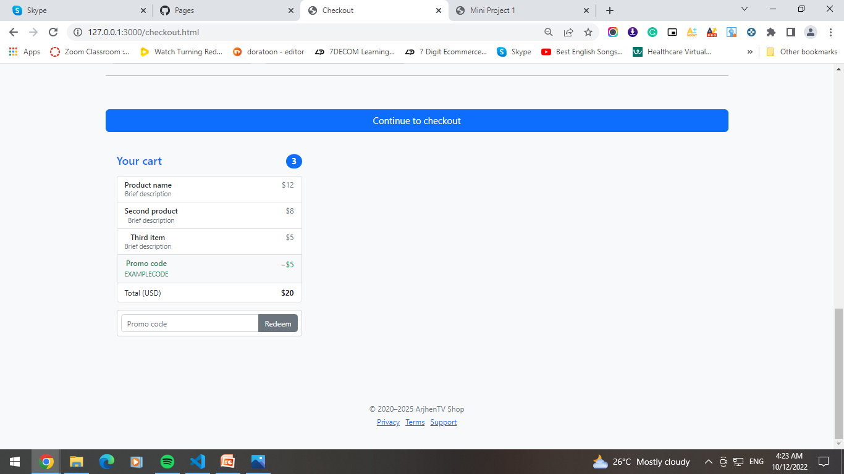
CHECKOUT FORM

Slide 27
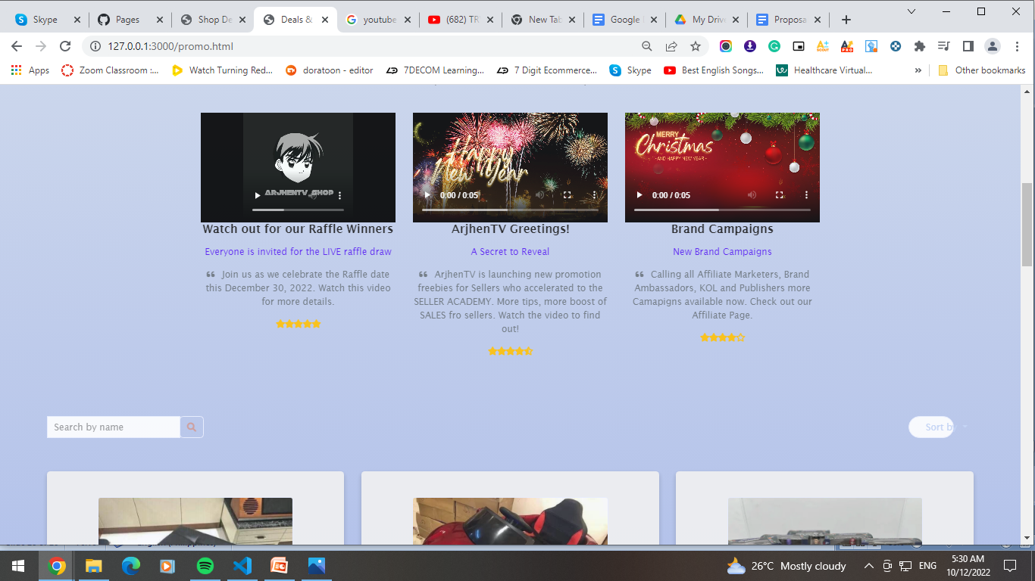
PROMO PAGE

